Slide 1
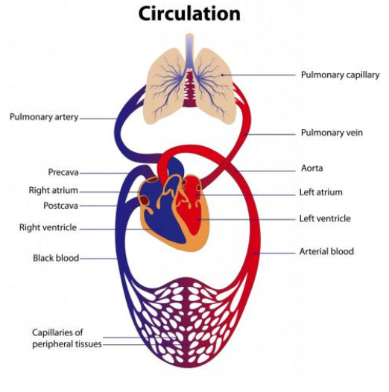
Healthy Me
Science – Circulatory System & Healthy Living
Vocabulary | Description
Circulatory System | The system that moves blood around the body.
Pulse/Heart rate | The rate of a heart beat per minute.
Transport | The movement of nutrients around the body.
Blood Vessels | A system of tubes that carry blood throughout the body. The main vessels are: Arteries, Veins, Capillaries.
Nutrients | A substance that is needed for healthy growth, development and functioning.
Oxygen | O2 – what the body needs to breath in.
Carbon Dioxide | CO2 – waste product from breathing.
Muscles | Tissue in the body of animals and humans that moves part of the body.

Slide 2
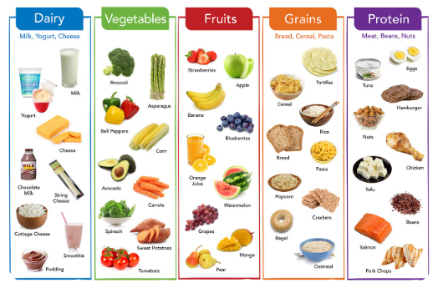
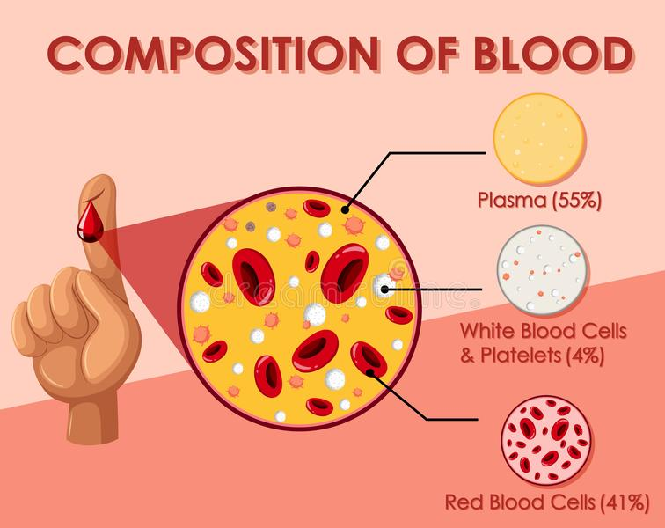
Healthy Me
Science – Circulatory System & Healthy Living
Vocabulary | Description
White Blood Cells | Used to fight infection and stop disease.
Red Blood Cells | Carry oxygen from the lungs to every cell in the rest of the body.
Platelets | Broken down parts of cells used to form scabs.
Plasma | Carries the blood cells and platelets around the body.

Slide 3
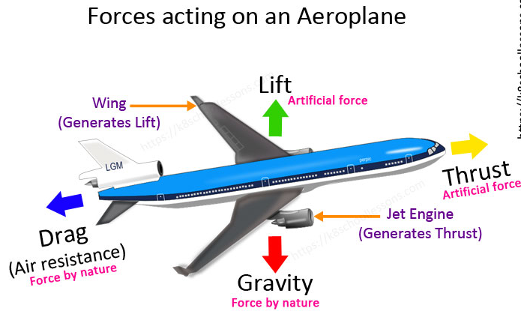
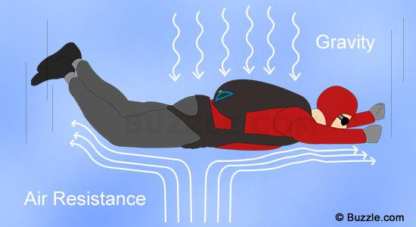
Healthy Me
Science – Forces (Friction and Air resistance)
Vocabulary | Description
Friction | A force that resists the sliding or rolling of one solid object over another.
Force | The strength or energy of movement. A force is a push or a pull action.
Resistance | Once force stopping another.
Gravity | The pull force of the Earth.
Levers | Lifting with a seesaw effect.
Pulleys | Changes the direction of the force.
Gears | Cogs/wheels of different sizes used to help movement.

Slide 4
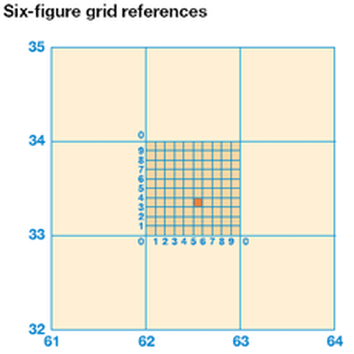
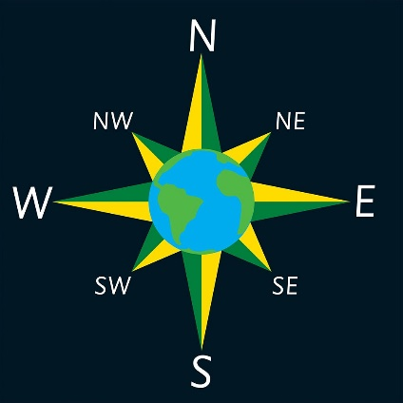
Healthy Me
Geography – Brazil
What is the grid reference for the orange square?
Along the Corridor: First, look at the horizontal axis numbers (x axis) to find first 2 digits.
Up the Stairs: Then, repeat for the vertical axis (y axis)
This gives you a 4 digit grid reference (62,33)
The diagram shows how to create the 6 figure grid reference.
625,333

Slide 5
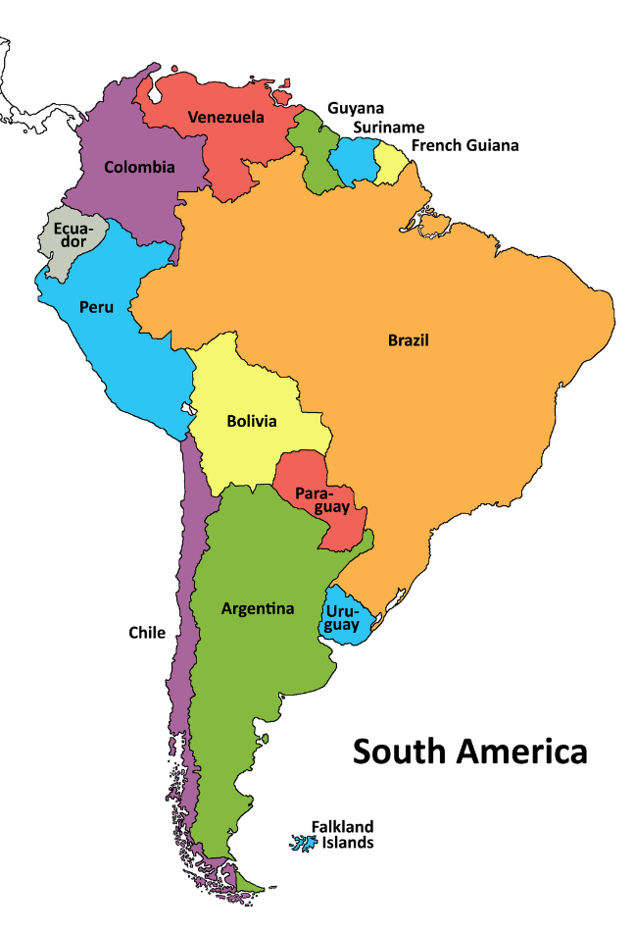
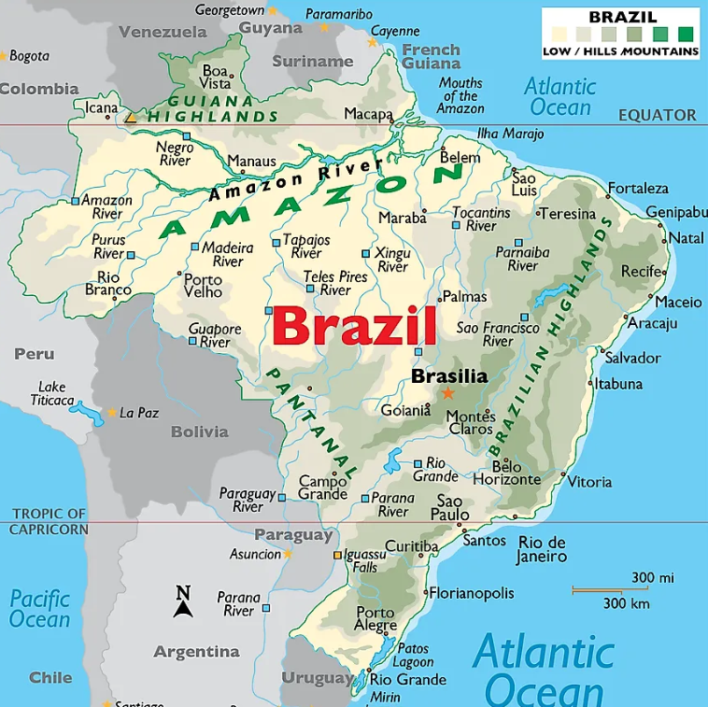
Healthy Me
Geography – Brazil
 | UK | Brazil
Continent | Europe | South America
Capital | London | Brasilia
Bordering countries | Republic of Ireland | Uruguay, Argentina, Paraguay, Bolivia, Peru, Colombia, Venezuela, Guyana and Suriname
Average Temp. (day) | 10.8 °C | 24°C
Currency | Pound (Sterling) | Brazilian Real
Language | English | Portuguese
Main Religion | Christianity | Roman Catholic
Famous Landmark | Big Ben (Queen Elizabeth Tower) | Christ The Redeemer, Copacabana Beach, Sugar Loaf Mountain
Famous food | Fish & Chips Tikka Masala | Picanha – Barbequed meats Locro – Chorizo stew
Sport | Football | Football

