Slide 1
The World Outside our Window
Year 3 and 4
Knowledge Organisor

Slide 2
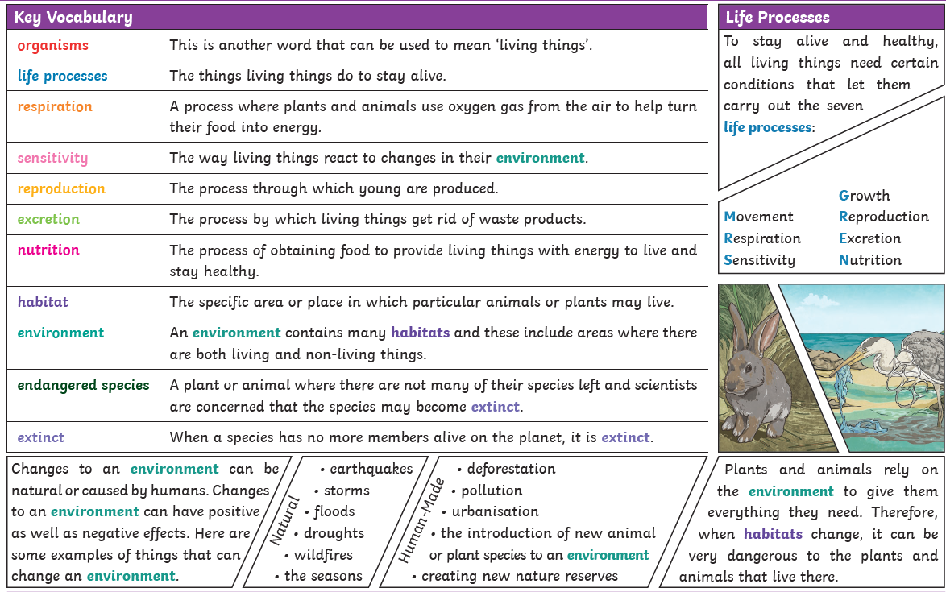
The World Outside our Window
Living things and their habitats
As part of this unit, we will be visiting How Hill.

Slide 4
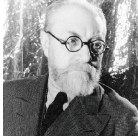
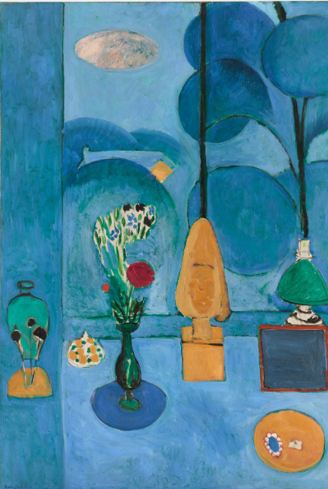
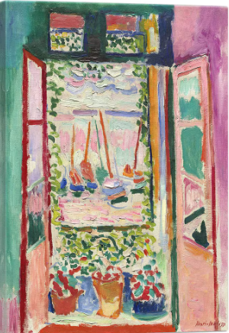
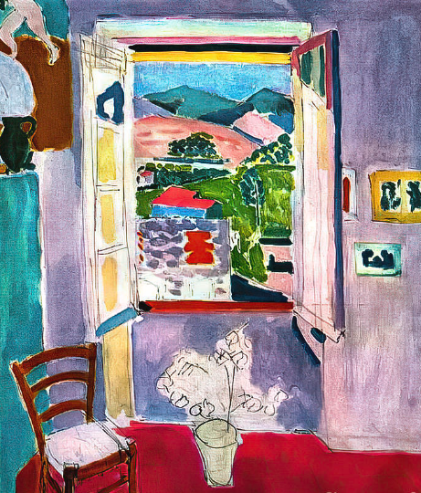
The World Outside our Window
Matisse painted lots of famous paintings that included windows throughout his career. We will be studying his paintings and creating our own versions.
The Blue Window The Open Window Open Window at Collioure

Slide 5
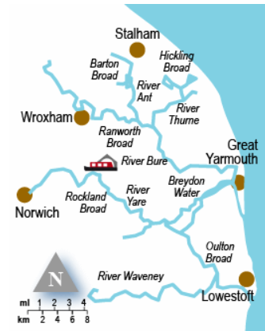
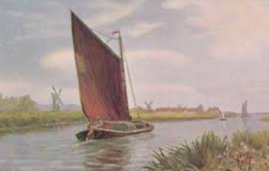
The World Outside our Window Year 3 and 4 Key Facts to support the learning we are doing about the history of the Norfolk Broads.
The Norfolk Broads
Rackheath
We are conducting a local history study. We are looking at the history of the Norfolk Broads.
The Norfolk Broads | The Norfolk Broads were accidentally man-made when land, which had been dug for peat, flooded. This happened in the 14th Century, about 700 years ago.
Peat | Peat was dug from the ground because it was a good source of fuel. A little like coal.
Wherry | The Wherry was a boat used to transport the peat to Norwich and Great Yarmouth.

Slide 6
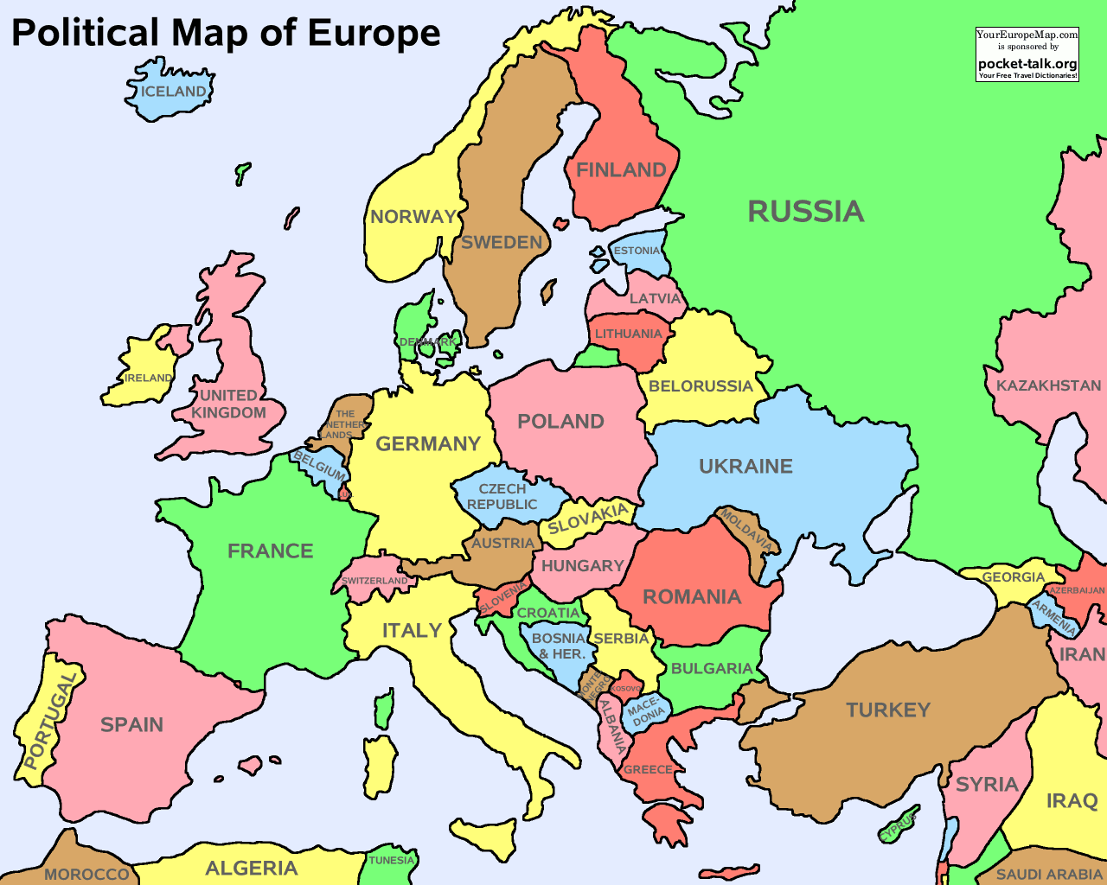
The World Outside our Window Year 3 and 4 Name and locate countries of the UK and Europe.
A map of the United Kingdom.
A map of Europe.

